Slide 1
Diesel Fire &Explosion hazards
Some Transport Fuel Properties
Unleaded Diesel
Mol.weight [C] 8 (4-12) 8 - 21
Density [g/ml] 0.71-0.77 0.83
Viscosity [mm²/s] 2.5 - 3.5
Flash Point [ºC] - 43 52 - 96
Auto Ignition Temp.[ºC] 280 256
LFL [%] 1.7 must be compressed/
UEL [%] 7.6 heated to be ignited
Diesel generally considered to be a relatively
safe transport fuel

Slide 2
Ladbroke Grove Train Collision 05.10.1999 – 8.11 am
GW 125 HST (9 carriages)
Cheltenham→ Paddington ≈ 80 mph
165 Thames Turbo (3 carriages)
Bedwyn ← Paddington ≈ 50 mph
(Almost) Head-on collision at closing speed
≈130 mph = 200 km/hr
31 dead (7 HST + TTT 24)
227 taken to hospital
296 treated on site
Many life changing injuries from fire i.o. impact

Slide 3
Incident lnvestigation
Investigated for the HSC and the HSE Railway Inspectorate (HMRI)
by
- HSL Harpur Hill
British Transport Police (BTP)
Metropolian Police (METR)
AEA Technology (AEAT)
WS Atkins Rail Limited
Independent Consultants

Slide 4
Lord Cullen Inquiry
Summary of Terms of Reference:
What happened ?
What can be learned from HSE investigation into causes ?
What factors affect safety management on UK railways ?
How appropriate is current regulatory regime ?
What recommendations for improving safety on the future UK railway ?
ICCE focus: (2) and (5) for the use of diesel.
Presentation: (2)

Slide 5
What happened ?
The Thames Turbo Train (TTT) had left Paddington at 8.06 a.m. The driven was fully trained but not experienced: he had completed his training for this train and route only two weeks earlier.
He passed a Red signal only 700 m from the point of collision. This sign was very difficult to read: it had 7 SPADS (Signal Passed At Danger) in 5 years.
There were only 30 seconds after SPAD to the moment of collision, which was insufficient time for signal control and the automatic Warning System to be effective.
4. At the collision point the TTT switched onto the main line at the precise moment, that the 6.03 a.m. HST from Cheltenham arrived there.

Slide 6
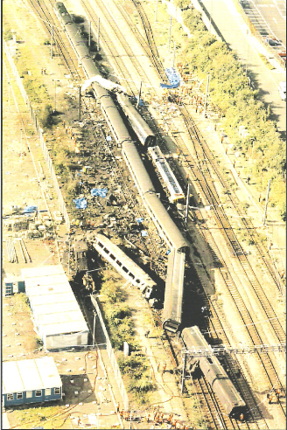
HST Rear
Power Car
TTT B3
TTT B2
TTT B1
HST Coach E
HST Leading
Power Car
HST Coach F
HST Coach H
HST Coach G
Paddington

Slide 7
Main Debris Field

Slide 8
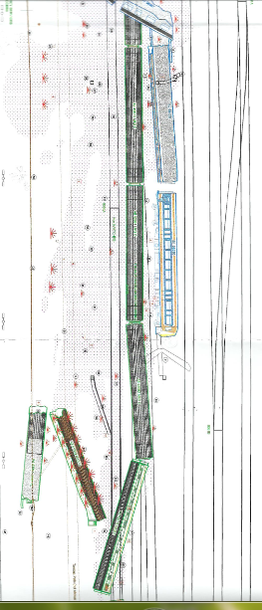
Diesel, Tanks & Fires in Debris Field
Diesel spill Small local Fierce Coach H HST Fuel
(~6 tonnes) fires fire tanks
(Thames 165 Tanks: B1 shattered, Tanks B2 and B3 attached)

Slide 9
Position and Fate of Fuel Tanks
TTT – B3 Tank = 1464 ltrs
Scattered on impact
HST – Tank 2 = 1966 ltrs
Cracked and fractured
HST – Tank 1 = 2710 ltrs
50% compressed, detached and
moved across debris field

Slide 10
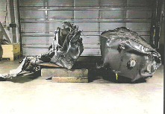
Post-collision HST Tanks

Slide 11
Questions ?
Why was there such an immediate and fierce fire inside Coach H that had been attached to the leading HST Power Car?
Without any major fires in the debris field, what had caused the number of greenery fires at the borders of the site ?
What had burnt off the paint from a number of coaches ?
Why did surviving passengers in other coaches describe that it felt as if they moved through a very bright and hot flame ?
How could this have been burning diesel if this had soaked parts of the debris area, but did not seem to have caught fire ?
Likely Cause:
A very short duration very high intensity and strongly radiating fire flash

Slide 12
Tank contents and dispersion
Fuel (in spec): Thames Turbo: HST:
Grade: Winter Summer
Flash Point: 65 ºC 81 ºC
AIT: 240 - 245 ºC 235-240 ºC
Dispersion: (~6000 ltrs)
HST 1:Half discharged over debris field, half at point of rest
HST 2:half dispersed; half discharged track ballast
B1: Discharged at rest point onto track ballast
B2: Discharged at rest point onto track ballast
B3: Atomisation and formation of dispersed and drifting fuel cloud (~ 500 kg?) raining down on debris field and entering Coach H through broken window

Slide 13
“Fire Dynamics”
Seconds after impact a heavily smoking and highly radiant “fire ball” from dispersed/atomised fuel moved along coaches and rose 20+ m, leaving a “mushroom” type cloud. Most likely of many potential ignition sources were the 25 kV overhead cables.
Significant quantities of falling burning fuel caused local trackside fires.
Short duration “linear” fires on the ballast and across the debris field.
A fierce fire within Coach H;
- For a couple of seconds the coach was dragged off the track to its rest position, sweeping around and collecting dispersed and burning fuel through its broken window.
- This initiated an additional 10+ second fireball within coach H, resulting in the worst burn injuries of victims.
- Ignition of internal fittings over 2-3 minutes, (allowing evacuation)
- “Flashover” phase leading to complete burnout of coach.

Slide 14
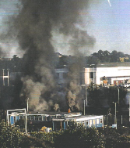
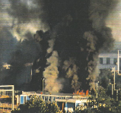
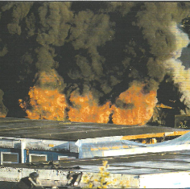
The Fire
Within moments of the crash a fire ball rose in excess of 20 m high and extending significantly towards Paddington
This was followed by formation of a black cloud over the scene
and a fierce fire inside HST Coach H, with flames pouring out of the broken windows

Slide 15
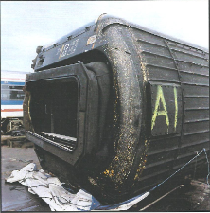
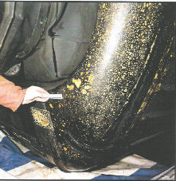
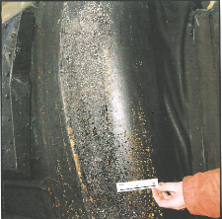
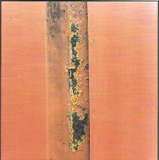
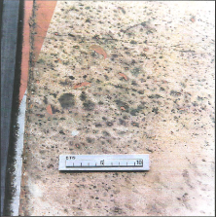
Evidence of Atomisation and Rainout
Hot liquid droplet impacts on leading edge of HST coaches
Hot liquid droplet impacts on Thames 165 panels

Slide 16
Atomisation Mechanism
In the reports the atomisation (of the fuel in the B3 tank) is ascribed to the compression and overpressure generated in the collision.
However, this is only the driving force that ejects and shears the
fuel through narrow cracks, slits and holes in the collapsing
containment.
This forms tin films of fast moving fluid that collapse at their
leading edge, forming multiple globules/drops of finely dispersed
fuel → mists (G.Andrews!)
Because the mists have a far greater fuel concentration than fuel
vapour and a high surface to volume ratio, they readily ignite.

Slide 17
HSL Impact and ignition simulation tests Harpur Hill Test Site
2 tonnes ram
40+ mph
500 ltr diesel tank
barrier
Impact velocity ≈ 1/3rd of Ladbroke Grove incident
2/3rd 165 TT tank model
Open flame fires

Slide 18
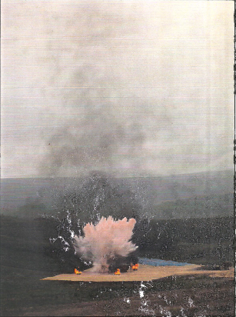
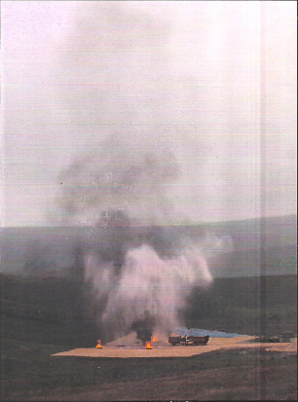
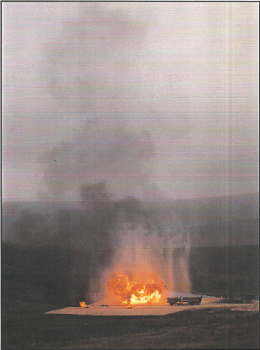

Slide 19
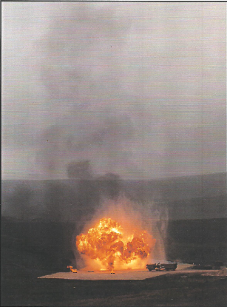
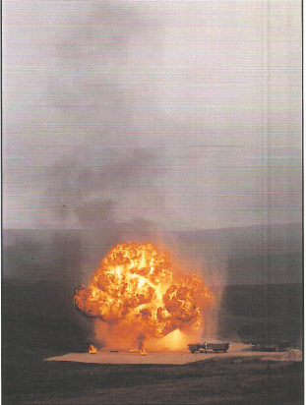

Slide 20
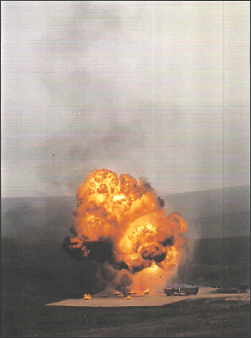
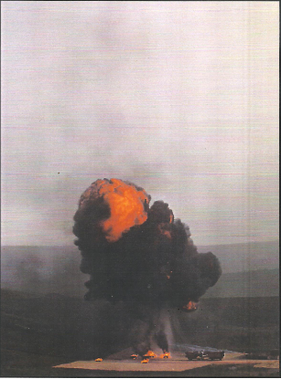
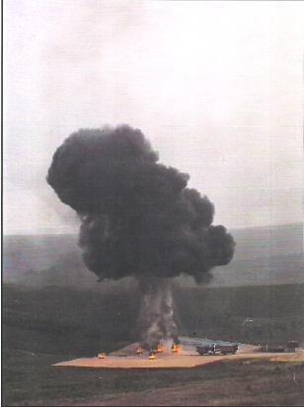

Slide 21
Findings and Conclusions
The impact velocity at the HSL tests was about 1/3rd of
that in the Ladbroke Grove incident. It was also only 80%
of the restricted speed of an HGV.
HSL tests showed that energy levels of 1% of the rail overhead cable supply will ignite a pool of diesel
2 Volt battery cells used in rail transport will ignite a diesel spray.
Thermite reactions in an impact of aluminium and rusted steel – such as may occur in high speed transport - will ignite diesel in all circumstances.
Diesel is clearly not a safe high speed transport fuel.

Slide 22
Subsequent developments
Lord Cullen recommended research into technology to avoid impact caused atomisation of transport fuels.
Referred to research by ICI and others, funded by the US Air Force, which produced promising results but stopped in the 1980s.
ICCE have developed an alternative solution, which is user- rather than supplier-specific.

Slide 23
Explosion Incidents Investigation and Evidence “A flying Crow always finds something”

Slide 24
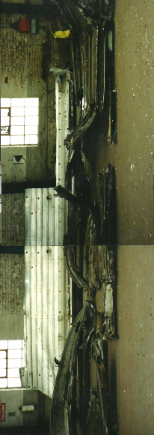
“I remember finding myself on a flat surface […roof of B1…]; there were patches of burning around me”
Coach B3 – Seat 23

