Slide 1
Fundamental Thoughts about Detonation
Derek Bradley
University of Leeds
UKELG 51st DISCUSSION MEETING
“Ignition and Explosion Hazards of Industrial Gas and Fuel Mixtures”
1st April 2014
Imperial College

Slide 2



Autoignition delay times for stoichiometric PRFs at 4 MPa

Slide 3





Requirements for Hot-spot Detonation
An autoignition front that propagates close to the acoustic speed: close to unity.
A high rate of energy release (excitation time, ) into the acoustic wave, as it propagates through the hot spot in a time of .
Rate of energy release indicated by: .
Hot-spot autoignition trigger is .

Slide 4
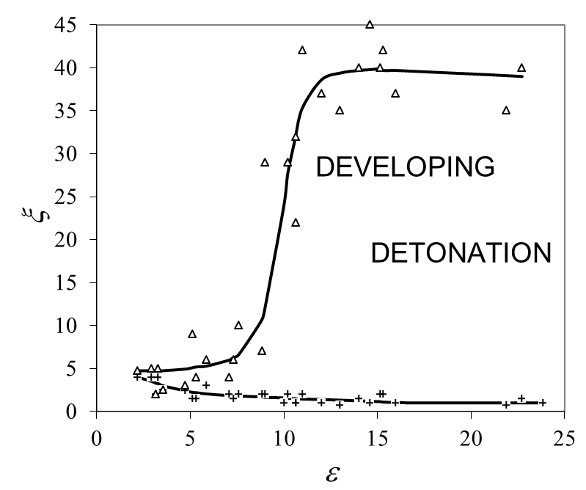


Regime Mapping from Hot-spot DNS with CO/H₂/air Detailed Kinetics

Slide 5
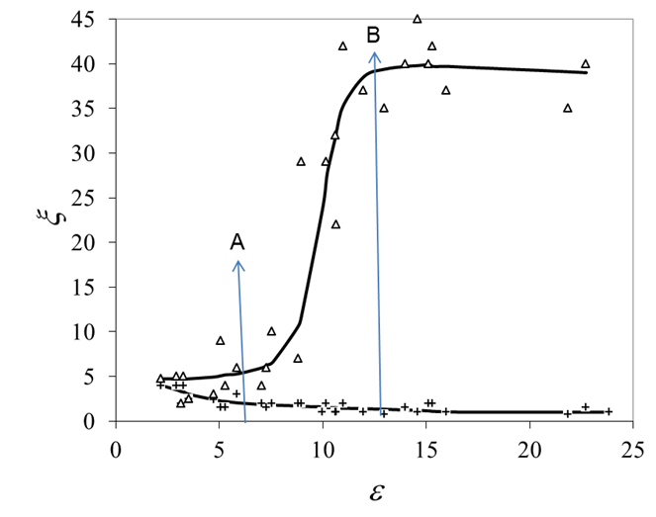

Limits of the Detonation Peninsula
*The bottom thermal explosion boundary has low values of ξ. As these increase, so does . At A the extent of the detonation regime is limited.
*At B this regime is extended by the increase in ε, but this gives a diminishing return.

Slide 6
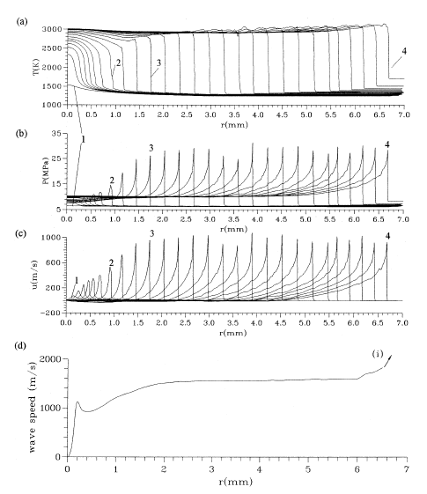
Hot-spot Detonation at Low ξ (=3, ε =22.7)

Slide 7
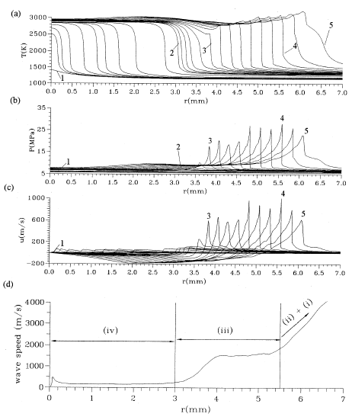
Hot-spot Detonation at High ξ (=10, ε =22.7)

Slide 8
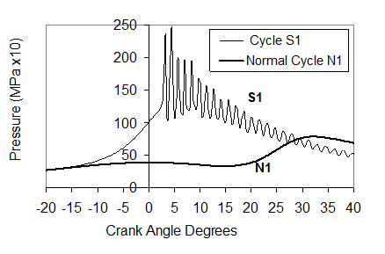
Engine Super-knock
(Courtesy of Dr P-W Manz, VW, Germany)

Slide 9
Increasing Severity of Engine Knock, N2 to E
Region of
very strong knock is at small values
of ε and ξ.

Slide 10
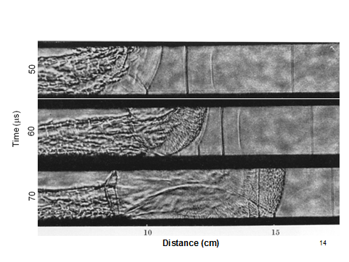
Detonation Transition in a Duct

Slide 11



Conditions for Strong Stable Detonations
Radulescu, Shepherd, and Sharpe have proposed that for strong, stable detonations, with minimal dependence on transverse shocks, should be small.
For super-knock, (ξε) should be small.
It can be shown that , with
as the autoignition trigger.

Slide 12
Conclusions
Quite a lot is known about transitions to detonations in ducts and engines, but less about transitions in storage depots and refineries.
Small scale events are crucial triggers for transition to detonation and for maintaining them.
ξ, ε, and E/RT, τ_{i}/τ_{e} , with reactivity gradient, are key parameters.
Small product values are associated with strong stable detonations in ducts and engines. They possibly provide more useful criteria for these than does detonation cell size.

Slide 13
References
Fieweger, K., Blumenthal, R. and Adomeit, G. 1997. Self-ignition of S.I. engine model fuels: a shock tube investigation at high pressure. Combust. Flame, 109, 599-619.
Gu, X.J., Emerson, D.R. and Bradley, D. 2003. Modes of reaction front propagation from hot spots. Combust. Flame 133, 63-74.
Bradley, D., Morley, C., Gu, X.J. and Emerson, D.R. 2002. Amplified pressure waves during autoignition: relevance to CAI engines. SAE paper 2002-01-2868.
Bradley, D. and Kalghatgi, G.T. 2009. Influence of autoignition delay time characteristics of different fuels on pressure waves and knock in reciprocating engines. Combust. Flame, 156, 2307-2318
Kalghatgi, G.T. and Bradley, D. Pre-ignition and ‘super-knock’ in turbocharged spark-ignition engines, International Journal of Engine Research, 13(4), (2012) 399–414.
Urtiew, P.A. and Oppenheim, A.K. 1966. Experimental observations of the transition to detonation in an explosive gas. Proc. Roy. Soc. Lond., A295, 13-28.
Bradley, D. Autoignitions and detonations in engines and ducts, Phil Trans. Royal Soc. A 370 (2012) 689-714.
Radulescu, M.I., Sharpe, G.J. and Bradley, D. A universal parameter quantifying explosion hazards, detonability and hot spot formation: the number, Proceedings of the Seventh International Seminar on Fire and Explosion Hazards, 2013, pp. 617-626, Research Publishing, Singapore. Eds. D. Bradley, G. Makhviladze, V. Molkov, P. Sunderland, F. Tamanini.

Slide 14
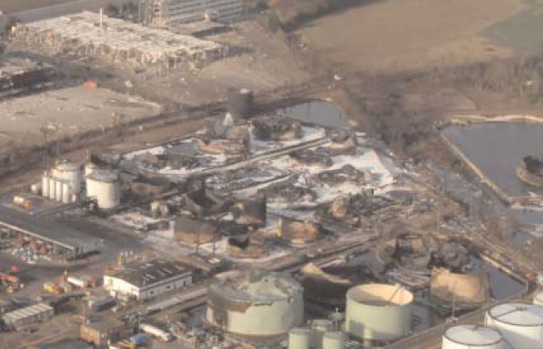
The End

